Slide 1

Saltwater Fly Fishing 101
How to get started fly fishing in saltwater

Slide 2
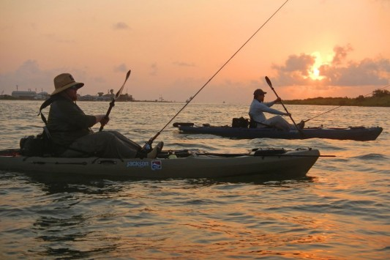
Things to know before you get started
It is a learning process that takes time
Success is never guaranteed
It is challenging for all experience levels

Slide 3
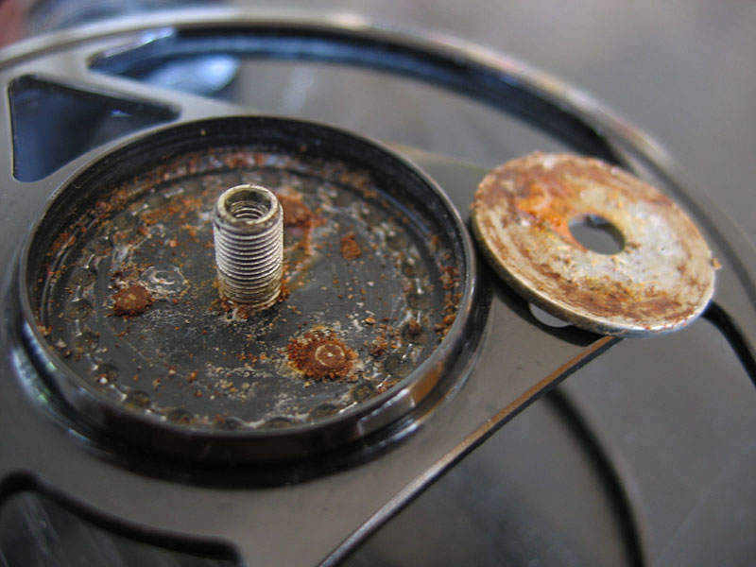
saltwater fly fishing Is different
Saltwater is a harsh environment for fly fishing
  Saltwater is corrosive
  The sun is intense.
  Wind blows
  Has things that sting, bite, cut, and hurt.
Most of the earth is covered with SW. How do you know where to start fishing?
Water conditions are always changing
  Water level affected by seasons, tide, wind, and weather in the gulf of Mexico
  Water clarity
  Water temperature
Bigger fish in saltwater!

Slide 4
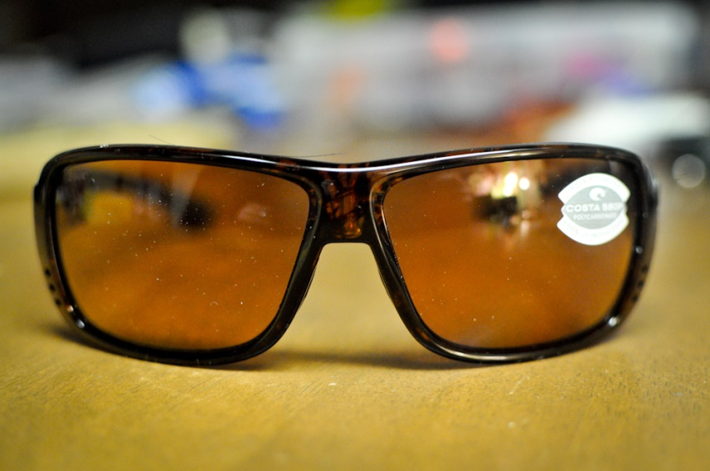
Basic requirements to get started:
Take care of yourself and your equipment
  Sun Protection
    Sun screen – use it on all exposed skin.
    Hat – wear it!
  Drink water to prevent dehydration
  Wear polarizing sunglasses – good optics are important for sight casting. You can’t catch them if you can’t see them.
  Footwear
  Wading boots are best
  Old tennis shoes will work
    Absolutely no sandals or open toe shoes!

Slide 5
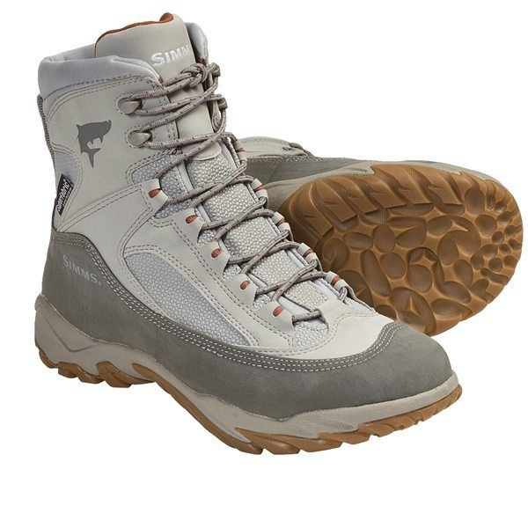
Basic requirements to get started
Fishing gear:
  Fly rod: 8 wt faster action rod
  Reel: Not as important as rod. Needs to be corrosion resistant.
  Fly line: weight forward, floating. Tropical grade for warmer climates is preferred.
  Leaders: 12-20 lb smooth tapered leaders. These fish are generally not leader shy.
  Tippet material is also handy to replace tippet sections.
  Hemostats with scissor feature, or separate line cutter.
  Flies
Rinse and clean all equipment with fresh water
  Avoid submerging in saltwater

Slide 6
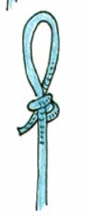
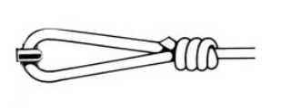



Basic Skills Required
Knots
  Non-slip Loop knot….. for tying on flies to leader
  Perfection Loop….. for connecting leader to fly line
  Double (or Triple) Surgeons knot….. for joining lines such as adding tippet to leader
  Blood Knot, Nail Knot….. are other knots to practice

Slide 7
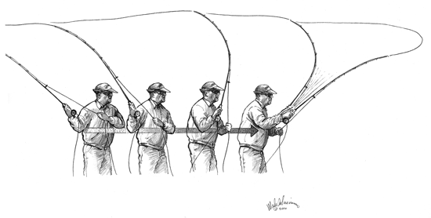
Basic Skills Required
Casting
  Learn to cast by loading the rod, stopping the rod, and shooting the line.
  Just ‘waiving’ the rod will not cast a fly in windy conditions
  Be able to cast accurately at a minimum of 30+ feet
  Second only to good optics, fly casting is the most important thing to know to be successful at saltwater fly fishing.

Slide 8
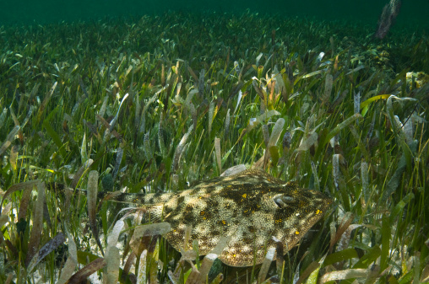
Basic Skills Required
Wading
  The “Texas Shuffle”
  Avoid
    picking your feet up off bottom
    backing up

Slide 9
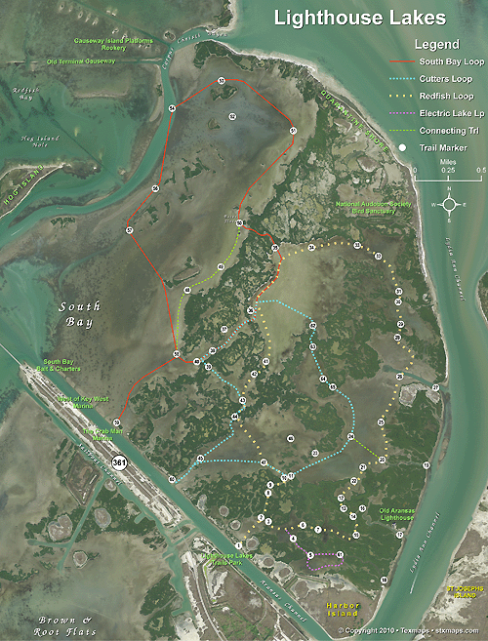
Ready to go Fishing (choices)!
Choosing a location Where do I go? There are so many places to choose from.
Accessing and fishing a chosen location
  Wade
  Kayak
  Boat
  Piers and Jetties
Sight Casting vs. Blind Casting
Water depth
Notes:
Where do I go?
There is a lot of water to choose from.
How do I access and fish these areas?
Wade
Kayak
Boat
Piers and Jetties
When is the best time to fish?
Day
Night
Sunrise and Sunset
Moonrise and Moonset
Major and minor
Incoming or outgoing tides
Seasons of the year
Sight Casting vs. Blind Casting
What water depth to fish?

Slide 10
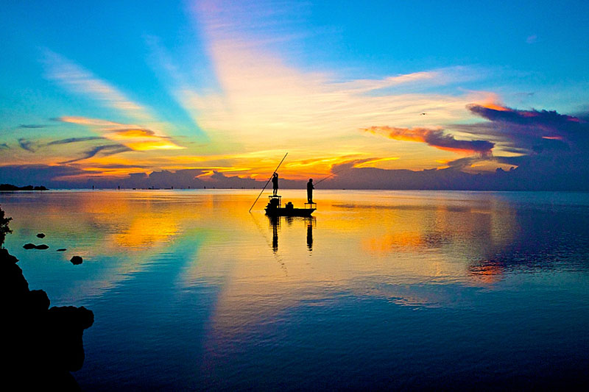
Ready to go fishing (choices)!
  The best time to fish
  Day/night
  Sunrise/mid-day/sunset
  Moonrise/Moonset
  Incoming (high)/outgoing (low) tides
  Major/minor tides
  Seasons of the year

Slide 11
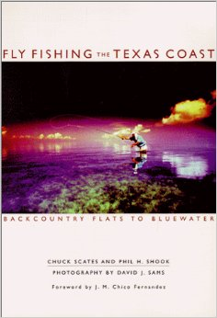
Reference books
Fly Fishing the Texas Coast – Backcountry Flats to Bluewater, by Chuck Scates and Phil H. Shook
Wade & Kayak Fishing on the Coastal Bend of Texas, by Ray Crawford
Saltwater Kayak Fishing The Texas Way – A Beginner’s Handbook, by Captain Sally Ann Moffett
Redfish on the Fly – A Comprehensive Guide, by Capt. John Kumiski
Photographic Guide to Fishing Saltwater Cuts, by Lefty Ray Chapa (e-book)

Slide 12
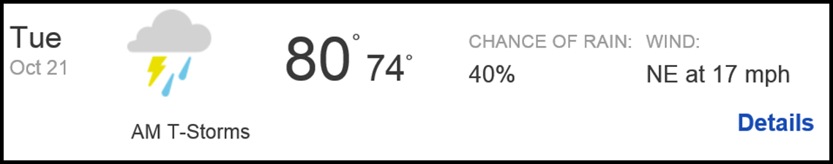
Research before and after trips
Google Maps.
  www.maps.google.com
  Use the ‘satellite’ view to zoom in for incredible detail!
  Weather Forecast
  Hourly up to 72 hours and daily up to 10 days
    http://www.intellicast.com/Local/Weather.aspx
  Check local reports of current and very recent weather conditions
    http://weather.k5bv.com/

Slide 13
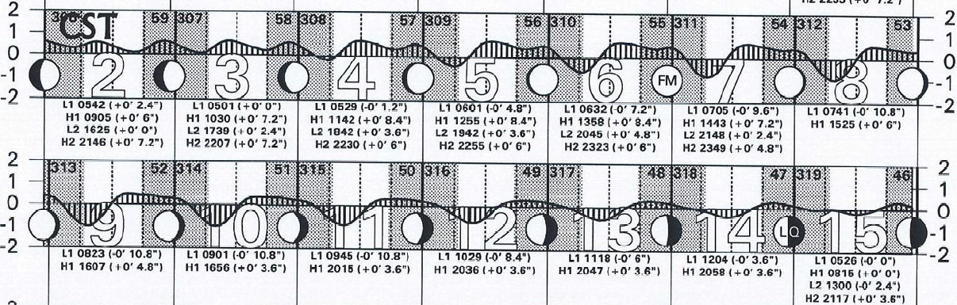
Research before and after trips
  Tide Predictions and actual recordings
  Monthly tide charts for Port Aransas Jetty: https://utmsi.utexas.edu/about/port-aransas-climate
  Tide forecasts and hindcasts for locations on the Texas coast (1-14 days): http://www.twdb.sta:e.tx.us/surfacewater/bays/tides/index.asp
  Current tide, wind, temperature, and barometer readings for locations on the Texas coast: http://tidesonline.nos.noaa.gov/plotcomp.shtml?station_info=8775237+Port+Aransas,+TX

Slide 14
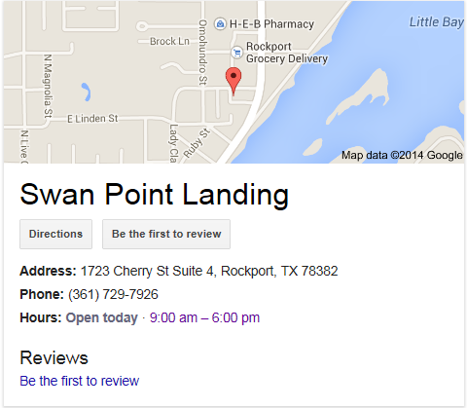
Fishing reports from Others
Websites:
  Texas Kayak Fisherman: http://www.texaskayakfisherman.com/forum/
  Corpus Fishing: http://www.corpusfishing.com/
  Texas Fishing Forum: http://texasfishingforum/com/
Facebook
  Billy Trimble
  Scott Null
  Scott Sommerlatte
  Captain Sally
  Eric Glass
  David Sikes
  Newsletters: Swan Point Landing
  weekly newsletter

Slide 15

Words of advice to beginners
  Don’t be discouraged by initial lack of success
  Celebrate the small things learned on each outing
  Don’t try to learn this on your own
  Spend time fishing with someone with more experience
  Practice being observant
  Use all of your senses to notice what is out of place
  Be laser focused
  Take your time
  Be thorough searching for clues in the water ahead
  Fish as often as possible, regardless of weather and water conditions because there no substitute for actual time spent on the water!

Slide 16
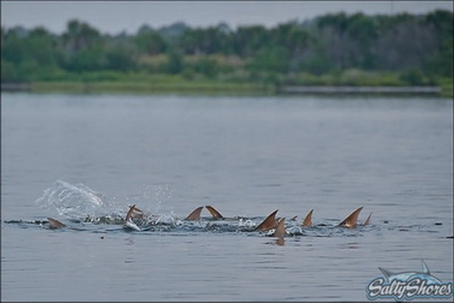
Tight Lines!

